Slide 1
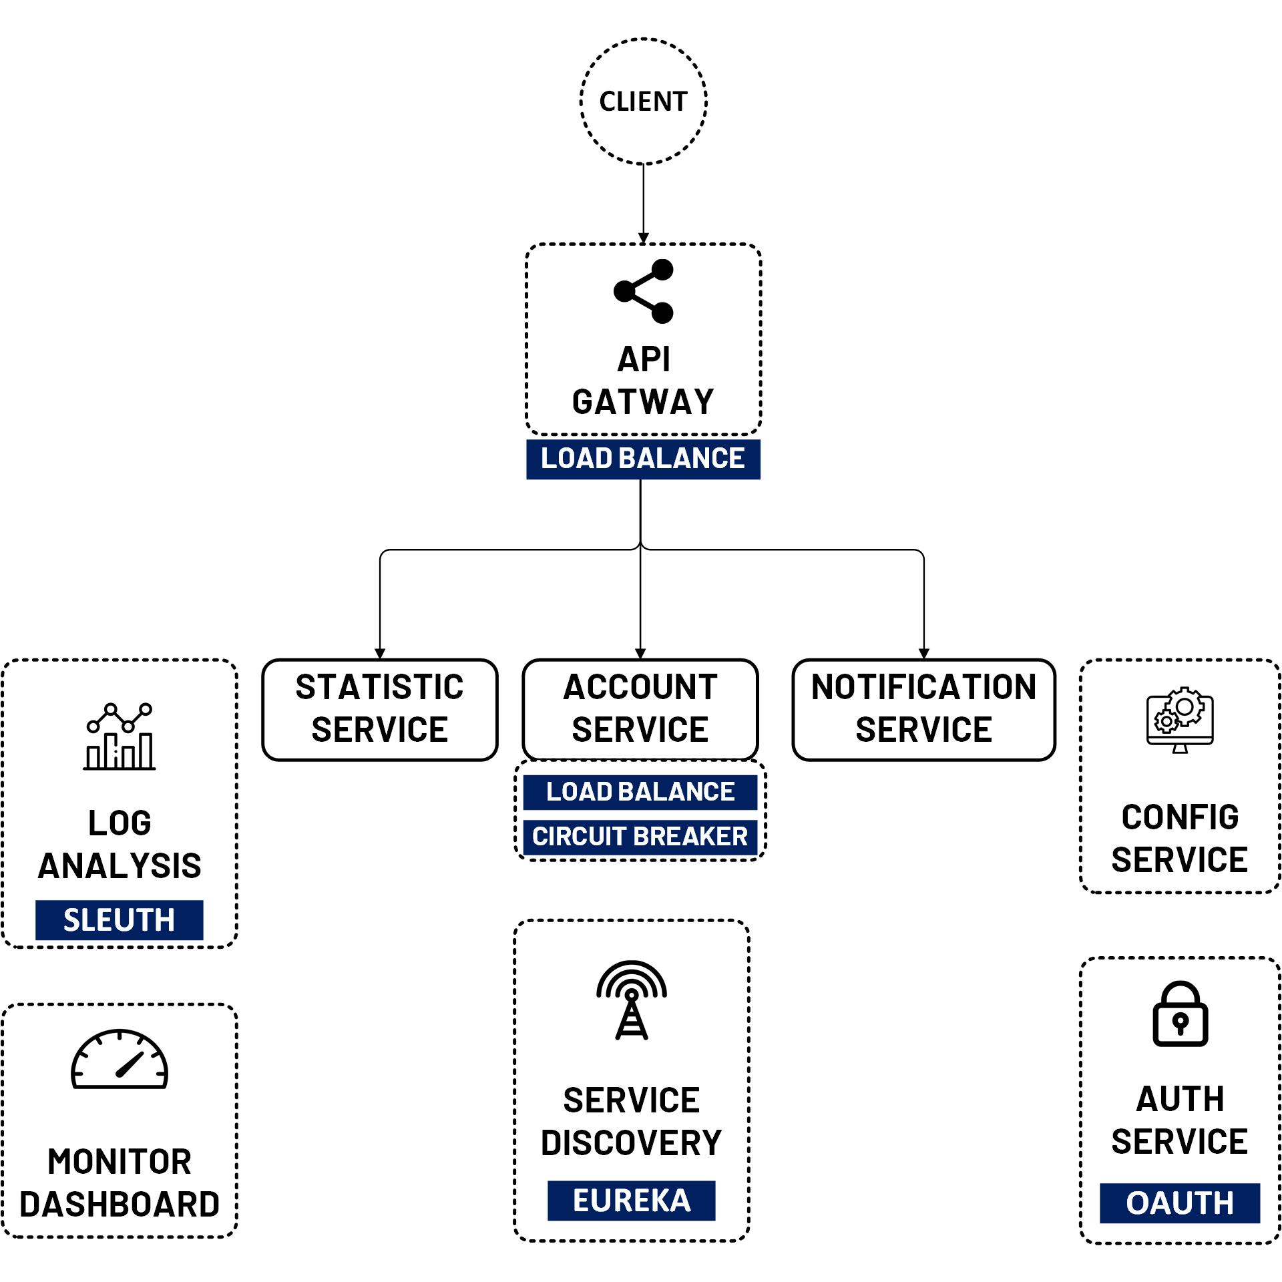

Create Notification Service with Spring Boot
www.jmaster.io/course/microservices-with-spring-cloud

